Slide 1
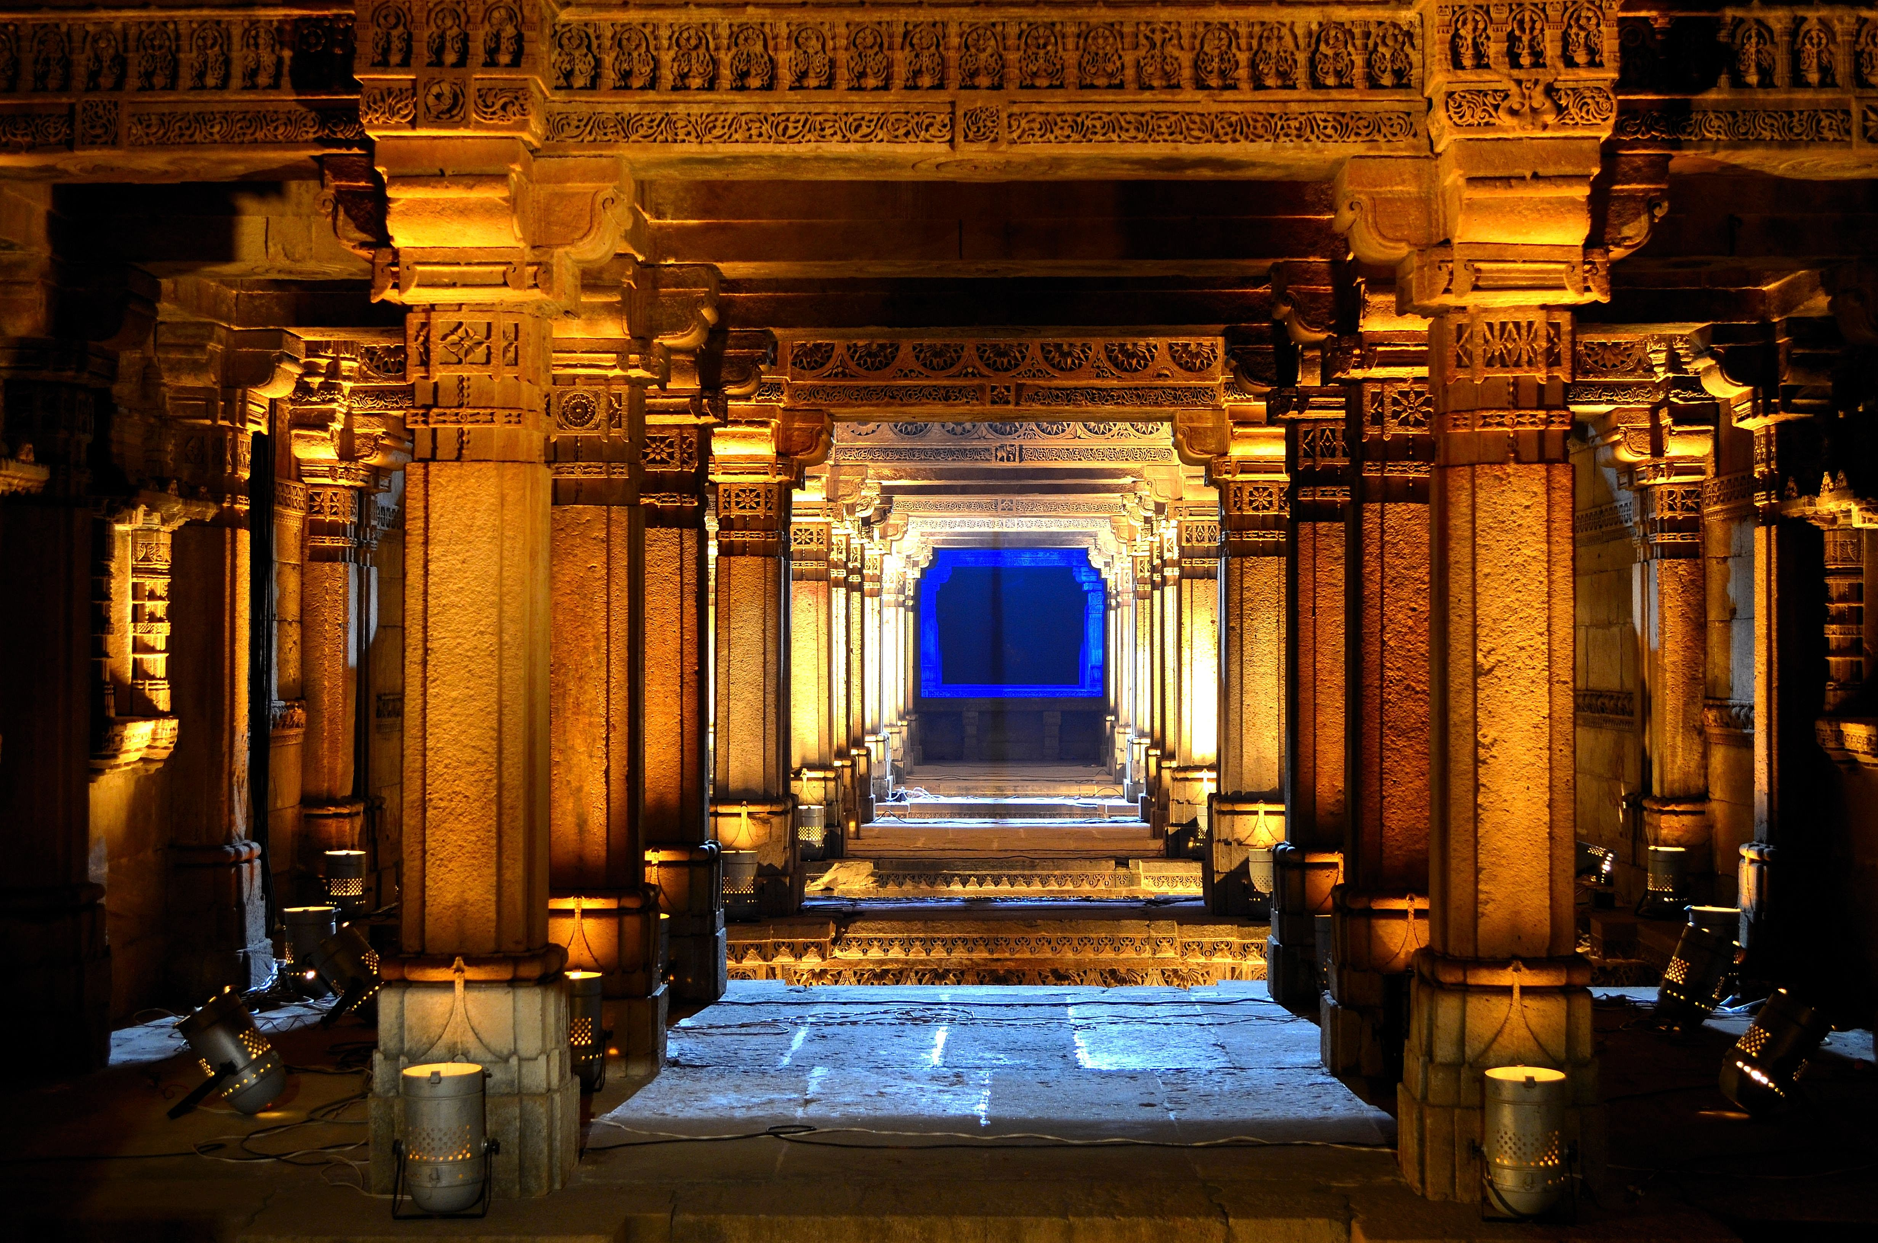
Travel Destination Website
TD
Travel Destination
Mini Project Presentation
Alex Victor
Jaimin Solanki
Keegan Vaz
Rohan Tondlekar
43
33
42
39
Date: 13th August 2020

Slide 2
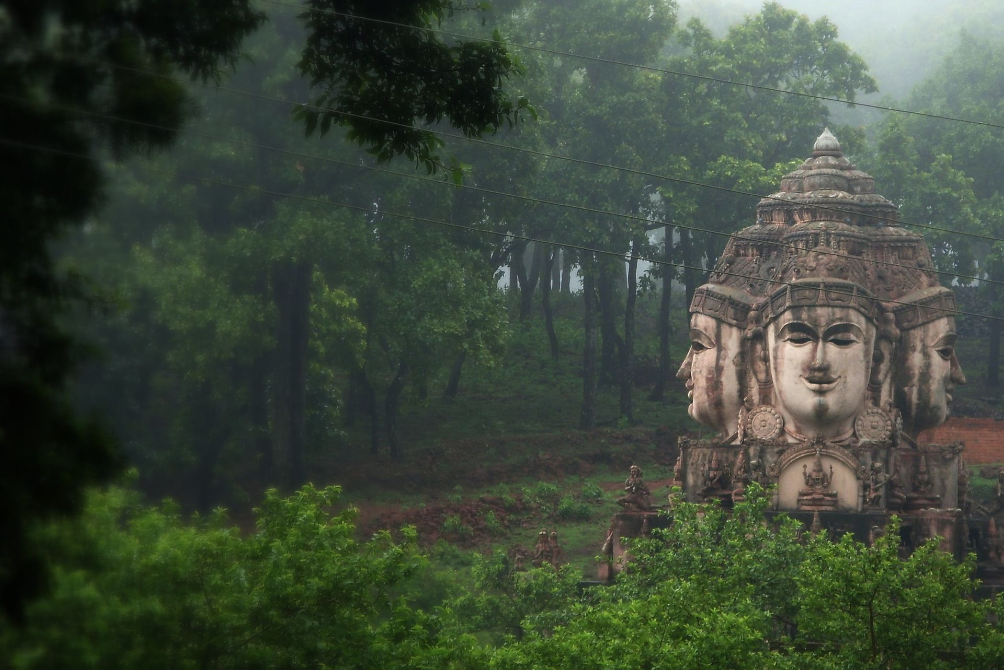
Introduction
TD
Travel Destination
Why Travel Destination Website?

Slide 3
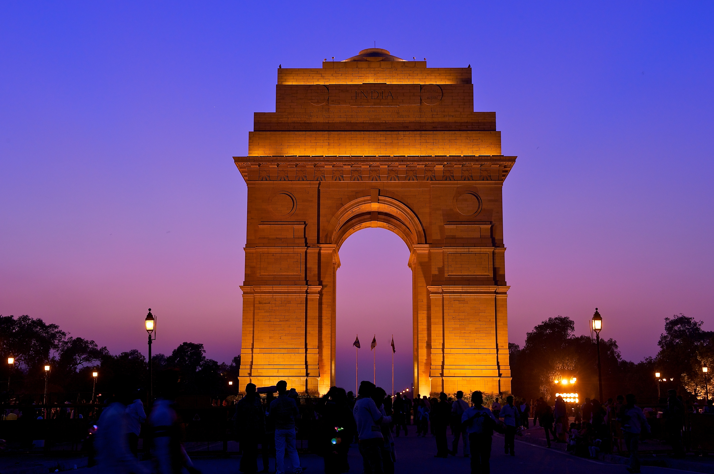
Our Main Motive
Why not find out Indian Culture than going someplace else.
The website will be an ordered collection which would be a guide for travel enthusiast and tourists.
It would be a booster for each state tourism as tourists.
State Tourism Department could use this information to promote tourism in their respective state.

Slide 4
Our Promise
Problem Definition
Travel
Awareness Creation
We want to make sure that unvisited and unheard travel destinations gain the limelight.
This will give our country a boost in the economy.
It will increase tourism in our country.
Our website would create an awareness of our country’s rich cultural heritage and monuments.
Discovering our country’s natural beauty.
Getting to know about the history of our countries not only by learning from our textbooks but visiting there.

Slide 5
Scope
Percentage of undiscovered places in India.
Tourism industry after this pandemic is on the verge to get revolutionized and this would be the best opportunity to promote tourism in India.
We could approach many tourism organizations to create good packages for these places.
Provide detailed information of each state and specialization of that state.
Growth of economy with the help of tourism.

Slide 6
Technologies Used
For Creating The Website.
JAVASCRIPT
HTML
PHP
CSS

Slide 7
Social Impact
Creating New Opportunities
Our website would make people aware about the places in India which they would include in their bucket list.
After getting to know the rich culture and heritage for our country a sense of pride would get inculcated among the citizens.
The countries economy will be benefited as Tourism would be promoted.
The remote places in India could create new job opportunities for the people.

Slide 8
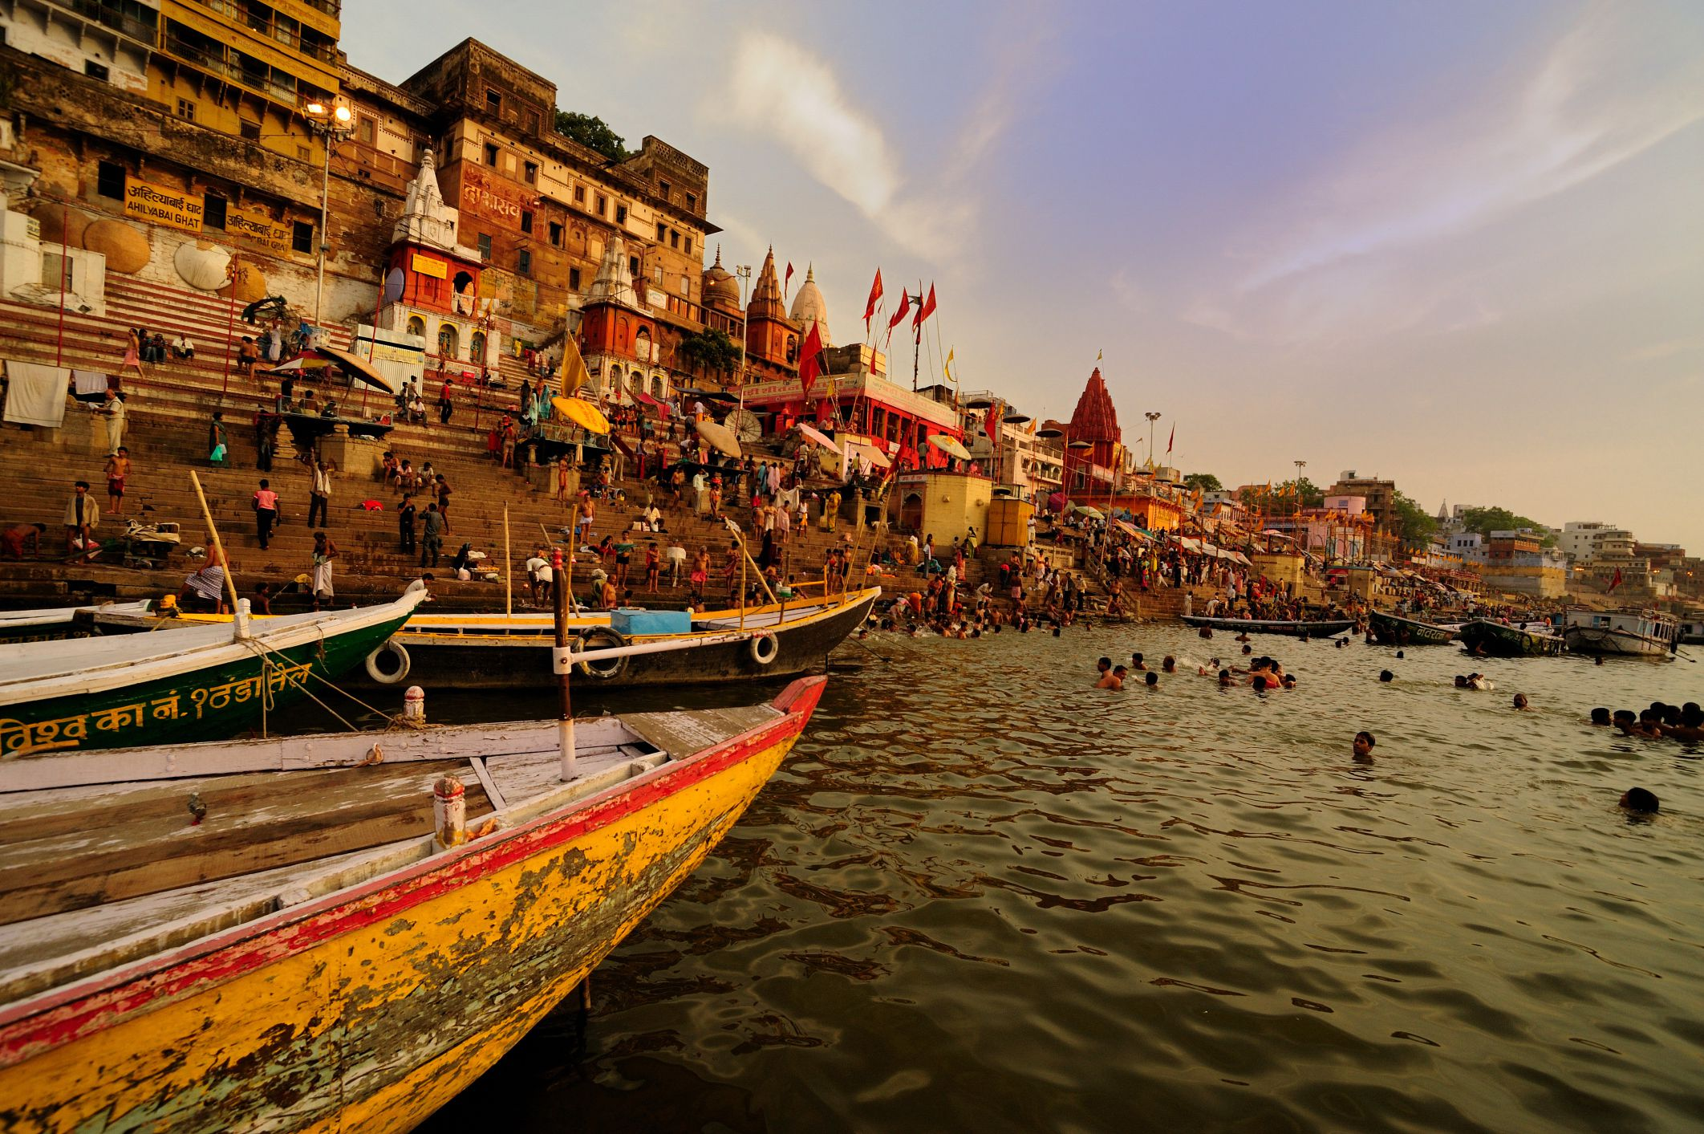
Reference
TD
1. Google
Travel Destination
2. Social Media

Slide 9
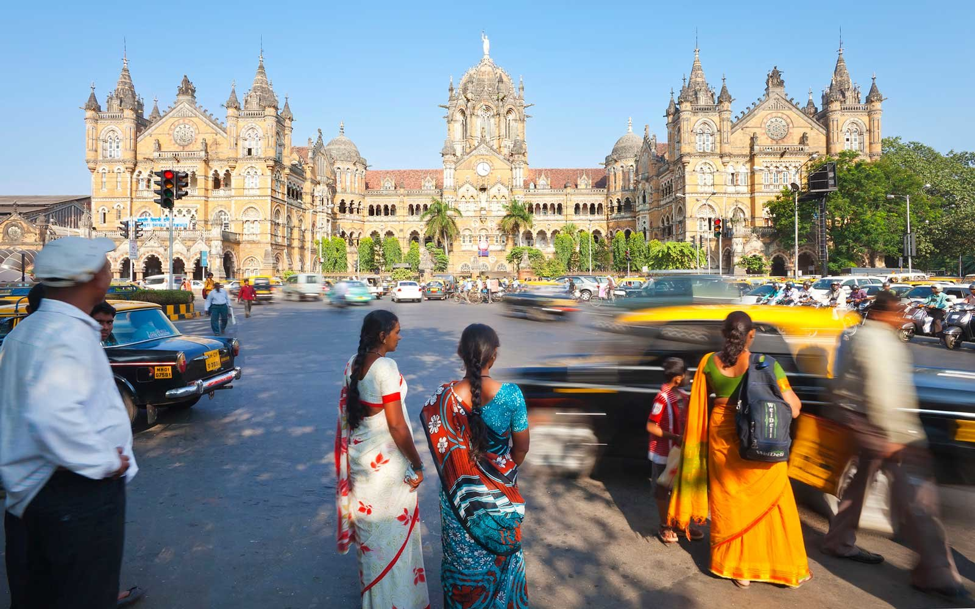
Thank You
TD
Feel Free To Ask Questions!
Travel Destination

